Slide 1
AZ-304: Microsoft Azure Architect Design
Presenter, MCT

Slide 2
Module 0: Welcome to AZ-304

Slide 3
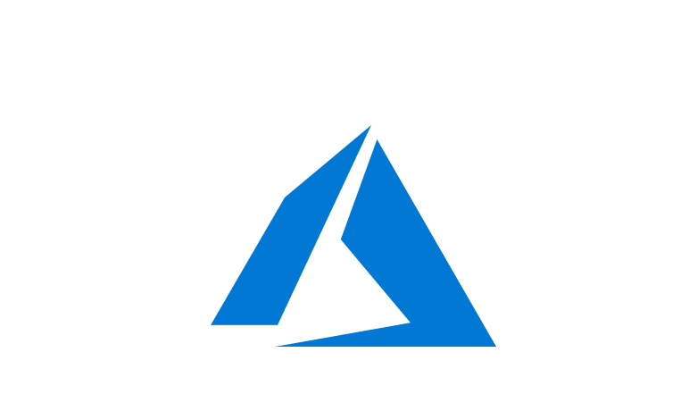
Welcome
We’ve worked together with the Microsoft Partner Network and Microsoft IT Academies to bring you a world-class learning experience.
Microsoft Certified Trainers + Instructors. Your instructor is a premier technical and instructional expert who meets ongoing certification requirements.
Customer Satisfaction Guarantee. Our partners offer a satisfaction guarantee, and we hold them accountable for it. At the end of class, please complete an evaluation of today’s experience. We value your feedback!
Certification Exam Benefits. After training, consider pursuing a Microsoft Certification to help distinguish your technical expertise and experience. Ask your instructor about available exam promotions and discounts.
We wish you a great learning experience and ongoing career success!

Slide 4
Instructor Introduction
Instructor: <Name>
<Title or other credentials, e.g., Microsoft Certified Trainer>
<Affiliation/Company>
<A few words about my technical and professional experience>

Slide 5
Student Introductions
Your name
Company affiliation
Title/function
Microsoft Azure experience
Your expectations for the course

Slide 6


Facilities
Class hours
Building hours
Parking
Restrooms
Meals
Phones
Messages
Smoking
Internet access
Recycling
Emergency procedures

Slide 7
Azure Architect Role
Azure Architects translate business requirements into secure and reliable recommendations for infrastructure, governance, high availability, cost optimization, and data integration.
Skills include recommending solutions for logging, multi-factor authentication, SSO, hybrid identity, backup and recovery, containers, microservices, monitoring, automation, networking, and application infrastructure.

Slide 8
About this Course: Prerequisites
Successful Azure Architects start this role with experience on operating systems, virtualization, cloud infrastructure, storage structures, governance, and networking.
Students possess the following knowledge and skills:
Understanding of on-premises virtualization technologies, including: VMs, virtual networking, and virtual hard disks.
Understanding of network configuration, including TCP/IP, Domain Name System (DNS), virtual private networks (VPNs), firewalls, and encryption technologies.
Understanding of Active Directory concepts, including domains, forests, domain controllers, replication, and Kerberos protocol.
Understanding of resilience and disaster recovery, including backup and restore operations.
Students should have a minimum of 12 months of hands-on experience with Azure.

Slide 9
Course Outline
This course is organized into Modules, Lessons, and Topics.
Module 1: Design a Compute Solution
Module 2: Design a Network Solution
Module 3: Design for Migration
Module 4: Design Authentication and Authorization
Module 5: Design Governance
Module 6: Design a Solution for Databases
Module 7: Select an Appropriate Storage Account
Module 8: Design Data Integration
Module 9: Design a Solution for Logging and Monitoring
Module 10: Design a Solution for Backup and Recovery
Module 11: Design for High Availability
Module 12: Design for Cost Optimization
Module 13: Design an Application Architecture
Module 14: Design Security for Applications
NOTE: This is a suggested order and aligns with the learning objectives described on the AZ-304: Microsoft Azure Architect Design certification page.

Slide 10
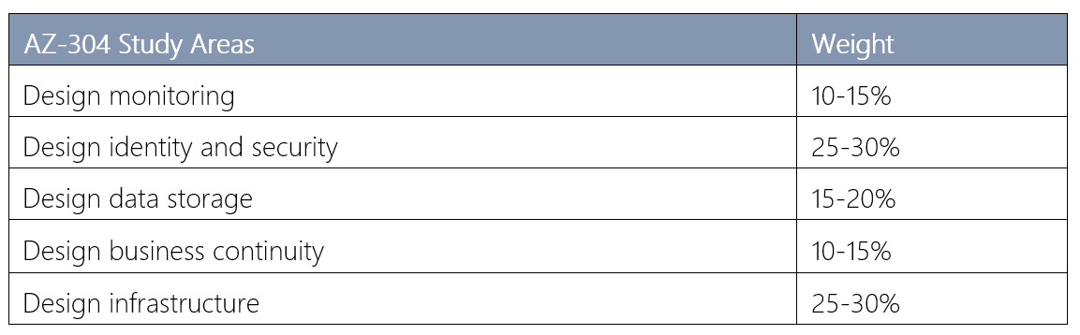
Certification (AZ-304)
Each study area has a percentage indicating the relative weight of the area on the exam. The higher the percentage, the more questions you are likely to see in that area.
For more information, see the AZ-304: Microsoft Azure Architect Design certification page.

Slide 11
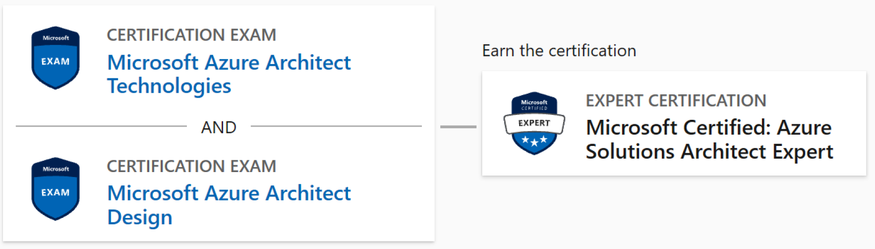
Microsoft Certifications
The AZ-304 Microsoft Azure Architect Design certification combined with the AZ-303 Microsoft Azure Architect Technologies certification result in the Microsoft Certified: Azure Solutions Architect Expert.
For more information, see the AZ-303 Microsoft Azure Architect Technologies page

Slide 12
Hands-on Labs (Optional)
You will use a Microsoft Learning Azure Pass to provide access to Microsoft Azure.
Check the dollar balance of you Azure Pass within Microsoft Azure once you have set up your subscription
Be aware of how much you are consuming and do not allow Microsoft Azure components to run overnight or for extended periods
Lab instructions are in a GitHub repository. For this class use the <your region> location.
Each lab creates a new resource group. To minimize costs, remove the resource group at the end of the lab.

Slide 13
Additional Resources (Optional)
Azure Tuesdays with Corey. Corey Sanders answers your questions about Microsoft Azure - Virtual Machines, Web Sites, Mobile Services, Dev/Test etc.
Azure Fridays. Join Scott Hanselman as he engages one-on-one with the engineers who build the services that power Microsoft Azure, as they demo capabilities, answer Scott's questions, and share their insights.
Microsoft Azure Blog. Keep current on what's happening in Azure, including what's now in preview, generally available, news & updates, and more.
Azure Documentation. Stay informed on the latest products, tools, and features. Get information on pricing, partners, support, and solutions.
Azure Architecture Center. The Azure Architecture Center provides best practices for running your workloads on Azure.
Azure Reference Architectures. Architecture diagrams, reference architectures, example scenarios, and solutions for common workloads on Azure.
Cloud Design Patterns. Cloud design patterns for building reliable, scalable, secure applications in the cloud.
Tailwind Traders. A three-tier legacy app re-written for modern cloud app ARM Solution

Slide 14
Thank you.

